Slide 1
Introduction to Graphics Lecture 2
Reading: Chp 2 of Text Book (Your First Step with WebGL)
Dr. Ubaid Abbasi

Slide 2
Outline
Shortest WebGL Program
Drawing a Point
Shaders
Vertex and Fragment Shaders
Draw Operation
WebGL Coordinate System

Slide 3
Shortest WebGL Program
See HelloCanvas.html and HelloCanvas.js

Slide 4
HelloCanvas.html
Defining the drawing area using <canvas> element
Import several other JavaScript files which provides useful convenience functions that help WebGL programming. Similar to libraries.

Slide 5
HelloCanvas.js
Consist of four main steps
Retrieve the <canvas> element
Get the rendering context for WebGL
Set the color clearing <canvas>
Clear <canvas>

Slide 6
1. Retrieve the <canvas> element
main() function retrieves the canvas element from the file
The argumet document.getElementById() method is used to retrieve the canvas element
In HTML file the attribute ‘id ‘ was set.
The return value of this method is stored in the canvas variable in js file

Slide 7
2. Get the Rendering Context for WebGL
<canvas> is designed to be flexible and supports both 2D and 3D
It doesn’t provide drawing method directly, instead it provides context that specifies which feature you want to use
var gl = WebGLUtils.setupWebGL(canvas)
Some books defines there own function for rendering the context for example

Slide 8
3. Set the Color for Clearing the <canvas>
In WebGL you need to set the color before actually cleaning the drawing area

Slide 9
Examples of other Colors

Slide 10
3. Set the Color for Clearing the <canvas>
Once you specify the clear color , the color is retianed in the WebGL system and not changed untill another color is specified by a call to
You don’t need to specify the clear color again if at some point in the future you want to clear area again using the same program

Slide 11
4. Clearing the <canvas>
Finally you can use the to clear the drawing area with the specified clear colors.
Why the argument is

Slide 12
4. Clearing the <canvas>

Slide 13
4. Clearing the <canvas>
If no color has been specified then following default value is used.

Slide 14
Experimenting with the Sample Program

Slide 15
What is a Shader?
Shader programs are necessary when you want to draw something on the screen in
Essentially, shader programs are embedded in the javascript file
WebGL needs following two types of shaders
Vertex Shader
Fragment Shader

Slide 16
Vertex Shader
Vertex shaders are programs that describe the traits
Position
Color and so on
The vertex is a point in 2D/3D space, such as the corner or intersection of a 2D/3D shape

Slide 17
Fragment Shader
A program that deals with per-fragment processing such as lighting.
The fragment is a WebGL term that you can consider as a kind of pixel.

Slide 18
Shaders
Its not enough to draw graphics . It is important how they are viewed as light sources, hit them or the viewer perspective changes
Shading does this with a high degree of flexibility and is part of the reason that today’s graphics are so realistic
Shading allows new rendering effects to achieve stunning results.

Slide 19
Shaders

Slide 20
Shaders

Slide 21
Example of shader Program ( HelloPoint.js)

Slide 22
HelloPoint.js
Are you familiar with this?

Slide 23
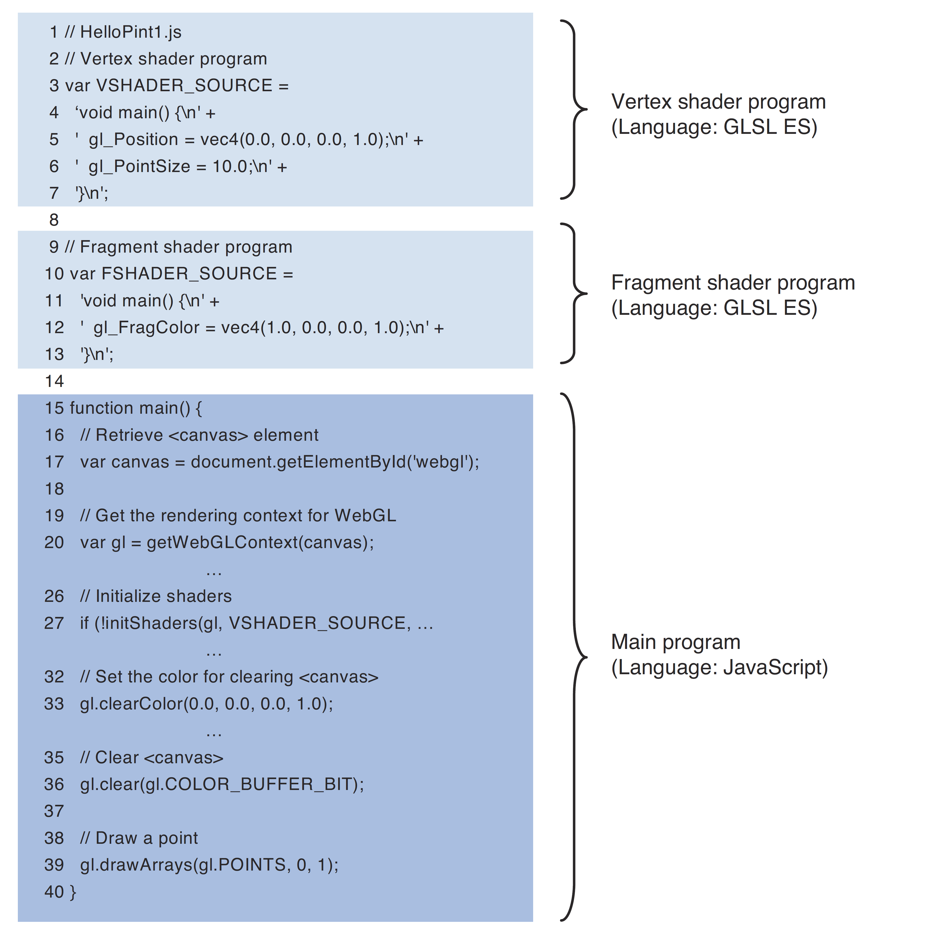

Slide 24
HelloPoint.js
These programs must be treated as a single string, therefore each line of the shader is concatenated using the + operator
Each line has \n at the end because the line number is displayed when an error occurs in the shader

Slide 25
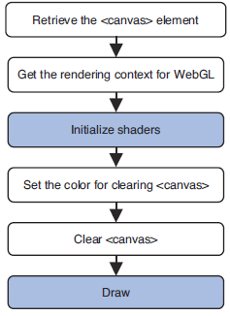
Initializing Shaders

Slide 26
Initializing Shaders

Slide 27
Behavior of initShader()

Slide 28
Homogeneous Coordinates
Vertex shader uses homogenous coordinate system (X,Y,Z,W)
The homogenous coordinates is equivalent to the three dimensional coordinate (X/W, Y/W, Z/W).
So, If you set W to 1 you can utilize homogenous coordinates as three dimensional coordinates .
Later on we will see if W=0, coordinates approaches to infinity , What does that mean to the graphics.

